Slide 1




DESAFIO
Gere planos de ação a partir de análises com SQL

Slide 2

Duplique este arquivo, responda e o submeta na plataforma
RESPOSTAS

Slide 3
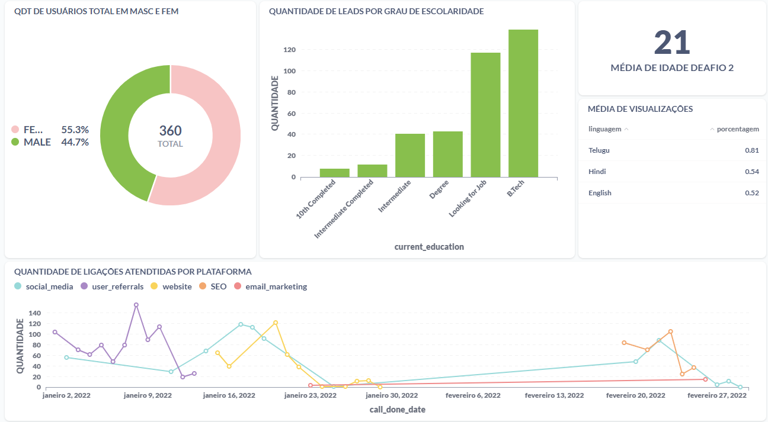
Dashboard

Slide 4
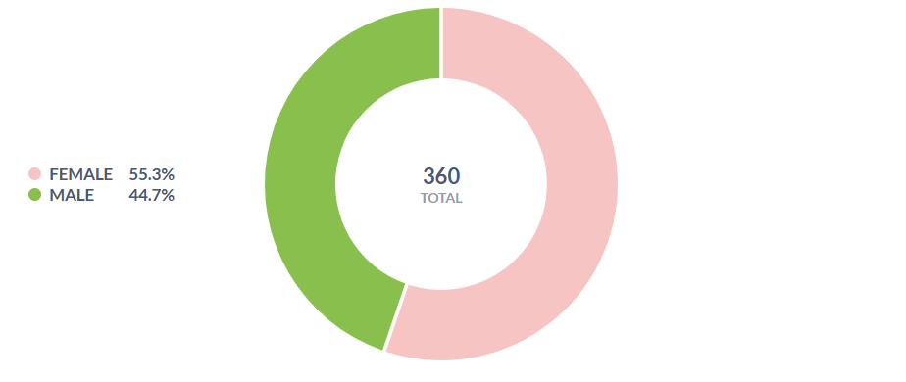
Gráfico 1 - PIZZA
Select
gender, count(lead_id)
from leads_basic_details
group by gender

Slide 5
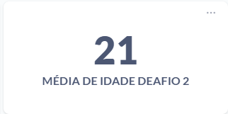
Gráfico 2 - CARTÃO
Select avg(age) from leads_basic_details

Slide 6
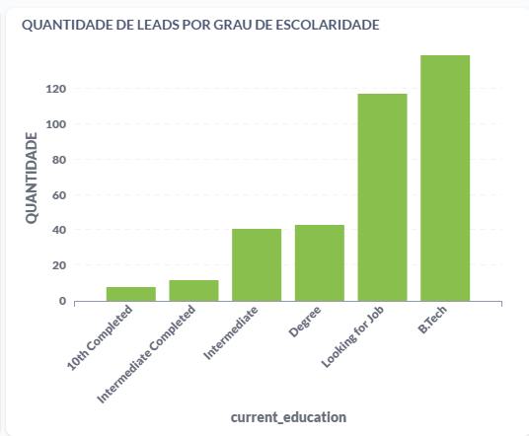
Gráfico 3 - BARRAS
Select
current_education, count(lead_id) as quantidade
from leads_basic_details
group by current_education
ORDER BY quantidade asc

Slide 7
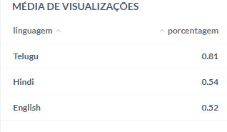
Gráfico 4 - TABELA
Select language as linguagem, watched_percentage as porcentagem from leads_demo_watched_details
where watched_percentage > 0.5
GROUP BY language

Slide 8
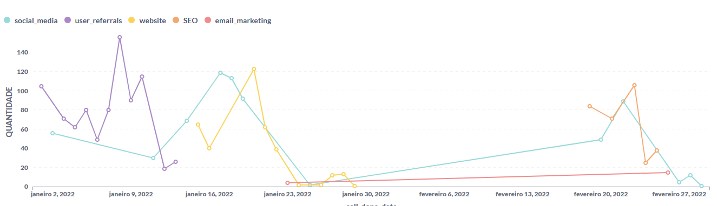
Gráfico 5 - LINHAS
Select lead_gen_source, call_done_date, count(call_status) from leads_basic_details lb
join leads_interaction_details li
on lb.lead_id = li.lead_id
where call_done_date <= '2022-03-01' and call_done_date >= '2022-01-01’
group by call_done_date

